Slide 1
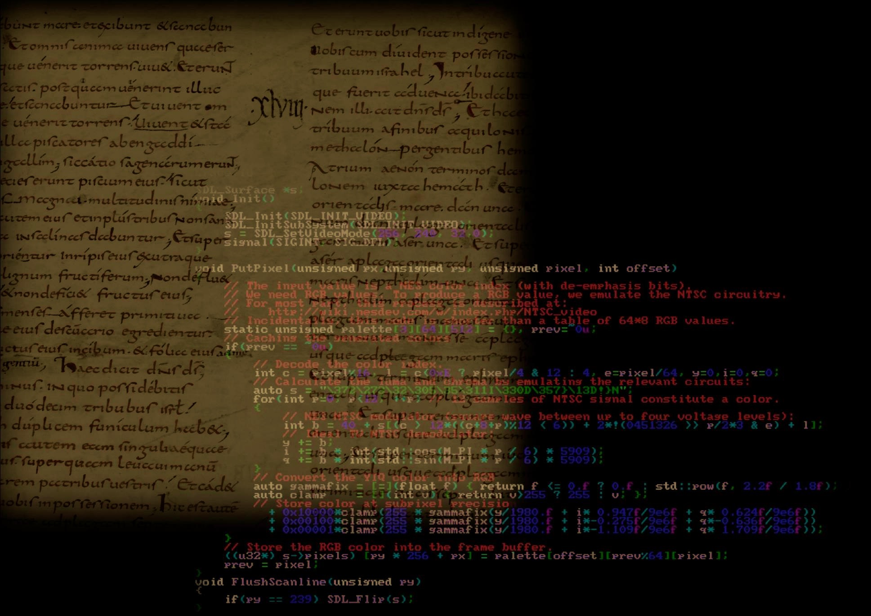
Call for Ideas@Roma Tre ______
IN CODICE RATIO
Paolo Merialdo
(Dipartimento di Ingegneria)
http://www.inf.uniroma3.it/db/icr/

Slide 2
GOALS & CONTENTS

Slide 3
Goal: building sw tools to support humanities scholars in the analysis of medieval manuscripts
In collaboration with the
Vatican Secret Archive

Slide 4
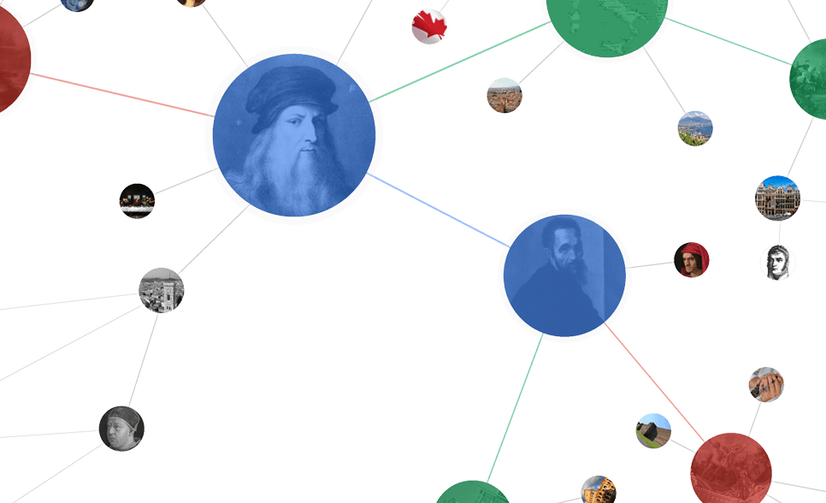
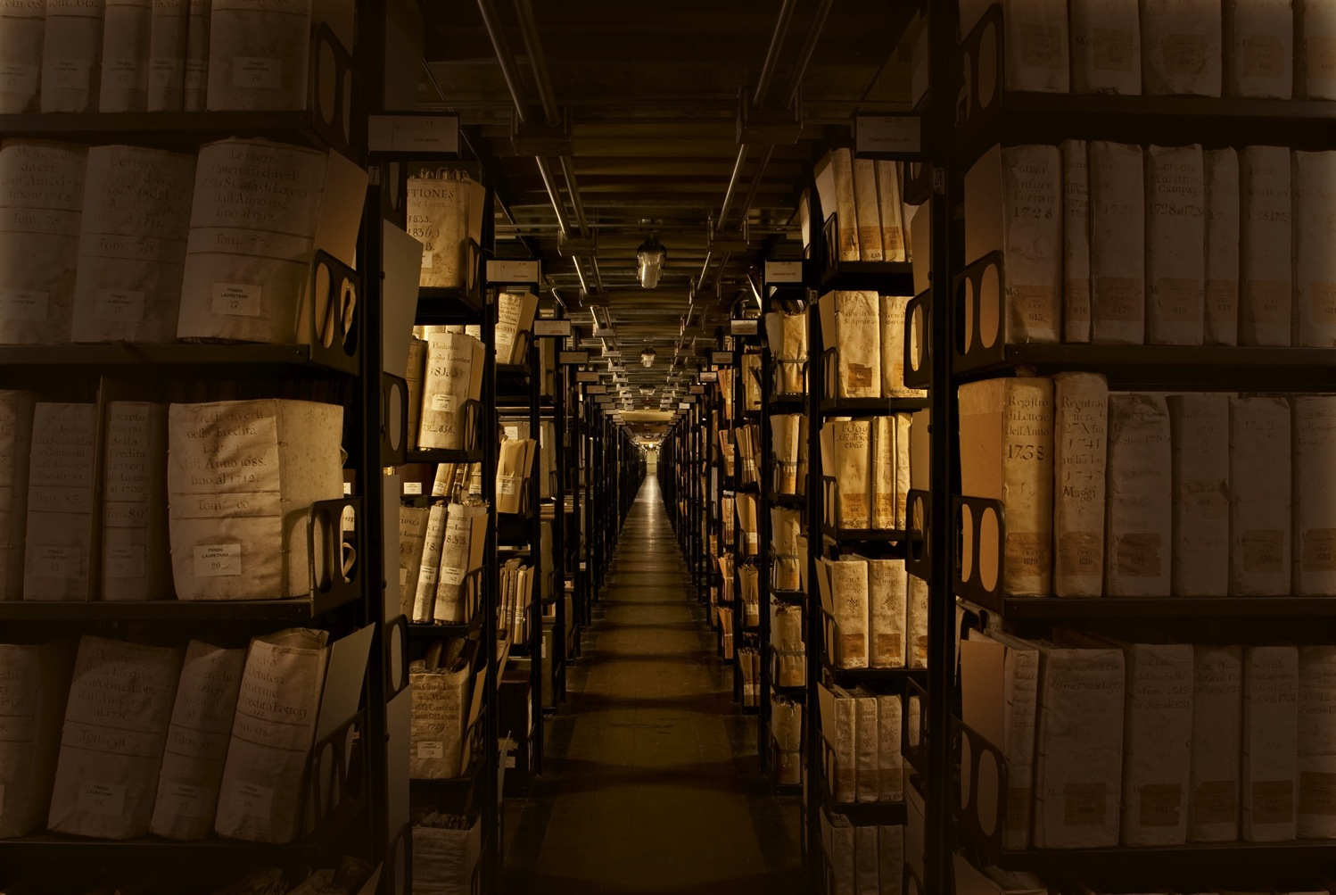
The Vatican Secret Archives
the largest historical archive
in the world
86 Km of shelving

Slide 6
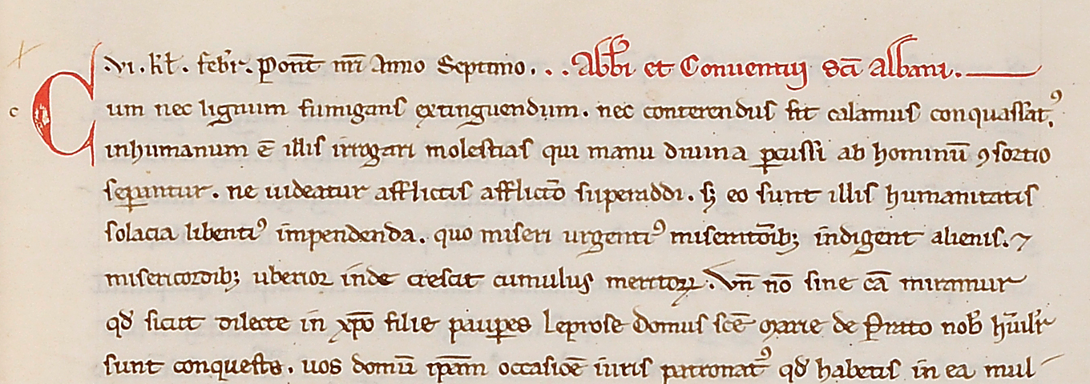

Slide 7
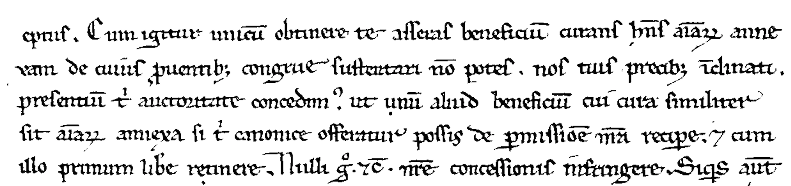
Problem
Input:
image
-eptus. Cum igitur unicu(m) obtinere te asseras beneficiu(m) curans h(abe)ns a(n)i(m)ar(um) anne-
xam de cuius p(ro)ventib(us) congrue sustentari no(n) potes nos tuis precib(us) i(n)clinati
presentiu(m) t(ib)i auctoritate concedim(us) ut unu(m) aliud beneficiu(m) cui cura similiter
sit a(n)i(m)ar(um) annexa si t(ib)i canonice offeratur possis de p(er)missio(n)e n(ost)ra recip(er)e et cum
illo primum lib(er)e retinere. Nulli (er)go et c(etera) n(ost)re concessionis infringere. Siq(ui)s aut(em)
Output:
text

Slide 8

AI reading medieval manuscripts
AI
huiuscemodi

Slide 9
PEOPLE

Slide 10
The project is inherently interdisciplinary
Machine Learning
Image processing
Data management
Paleography
Philology
History

Slide 11
Diversities (gender and disciplines)
Department of Engineering
  Donatella Firmani (rtda)
  Paolo Merialdo (prof)
  Elena Nieddu (phd student)
Department of Humanities
  Serena Ammirati (rtda)
  Andrea Vanni (rtd-b)
Department of Law
  Emanuele Conte (prof)
  Sara Menzinger Di Preussenthal (prof)

Slide 12
PROGRESS

Slide 13
Progress
We have developed an end-to-end pipeline to transcribe documents from the XII-XIV sec Popes' Registers (from raw images to text) with good accuracy
We have build a toy search engine, very appreciated by humanities scholars

Slide 14

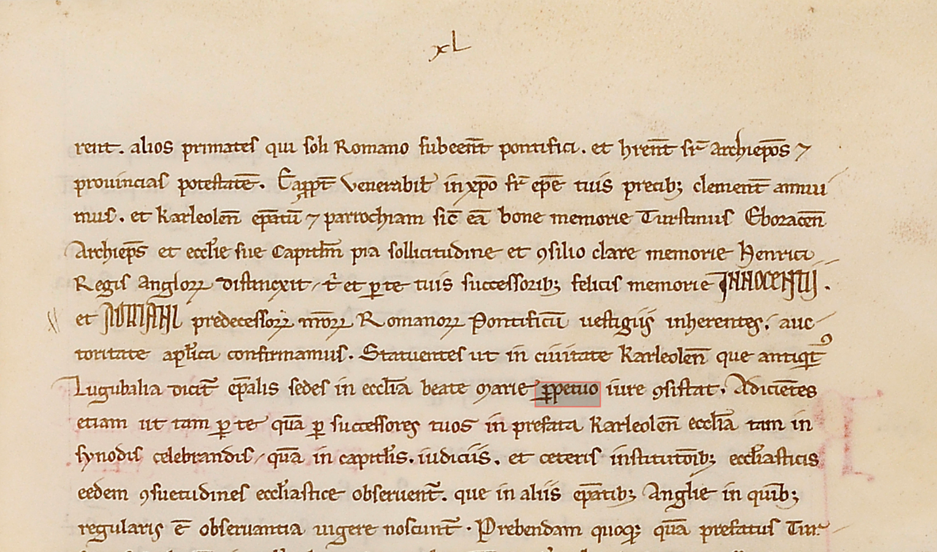

Slide 15
Progress: next steps
New manuscripts from different collections, possibly with new scripts
Build a complete search engine
Knowledge extraction from the transcribed text
Philological and historical analysis

Slide 16
Results so far
Scientific results
Third mission
Innovation fostering
Technology transfer

Slide 17
RESULTS
Scientific results
Third mission
Innovation fostering
Technology transfer

Slide 18
RESULTS
Scientific results
Third mission
Technology transfer

Slide 19
Scientific results
The project has been presented in many
conferences both CS and humanities
(see the web site for a list of publications)
We are preparing a journal paper that
describe our Handwritten Text Recognition
pipeline

Slide 20
RESULTS
Scientific results
Third mission
Technology transfer

Slide 21
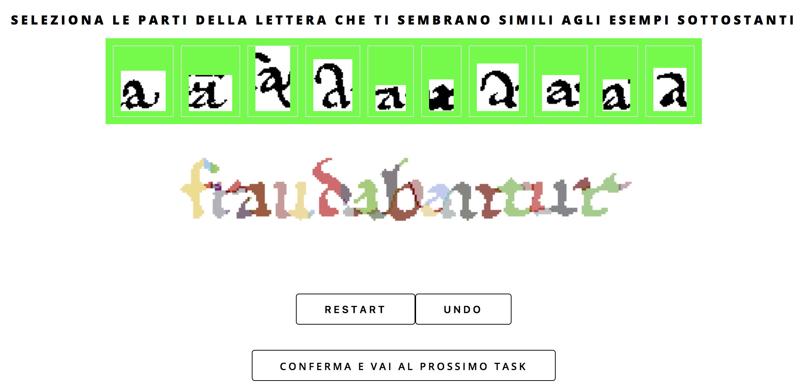

Slide 22
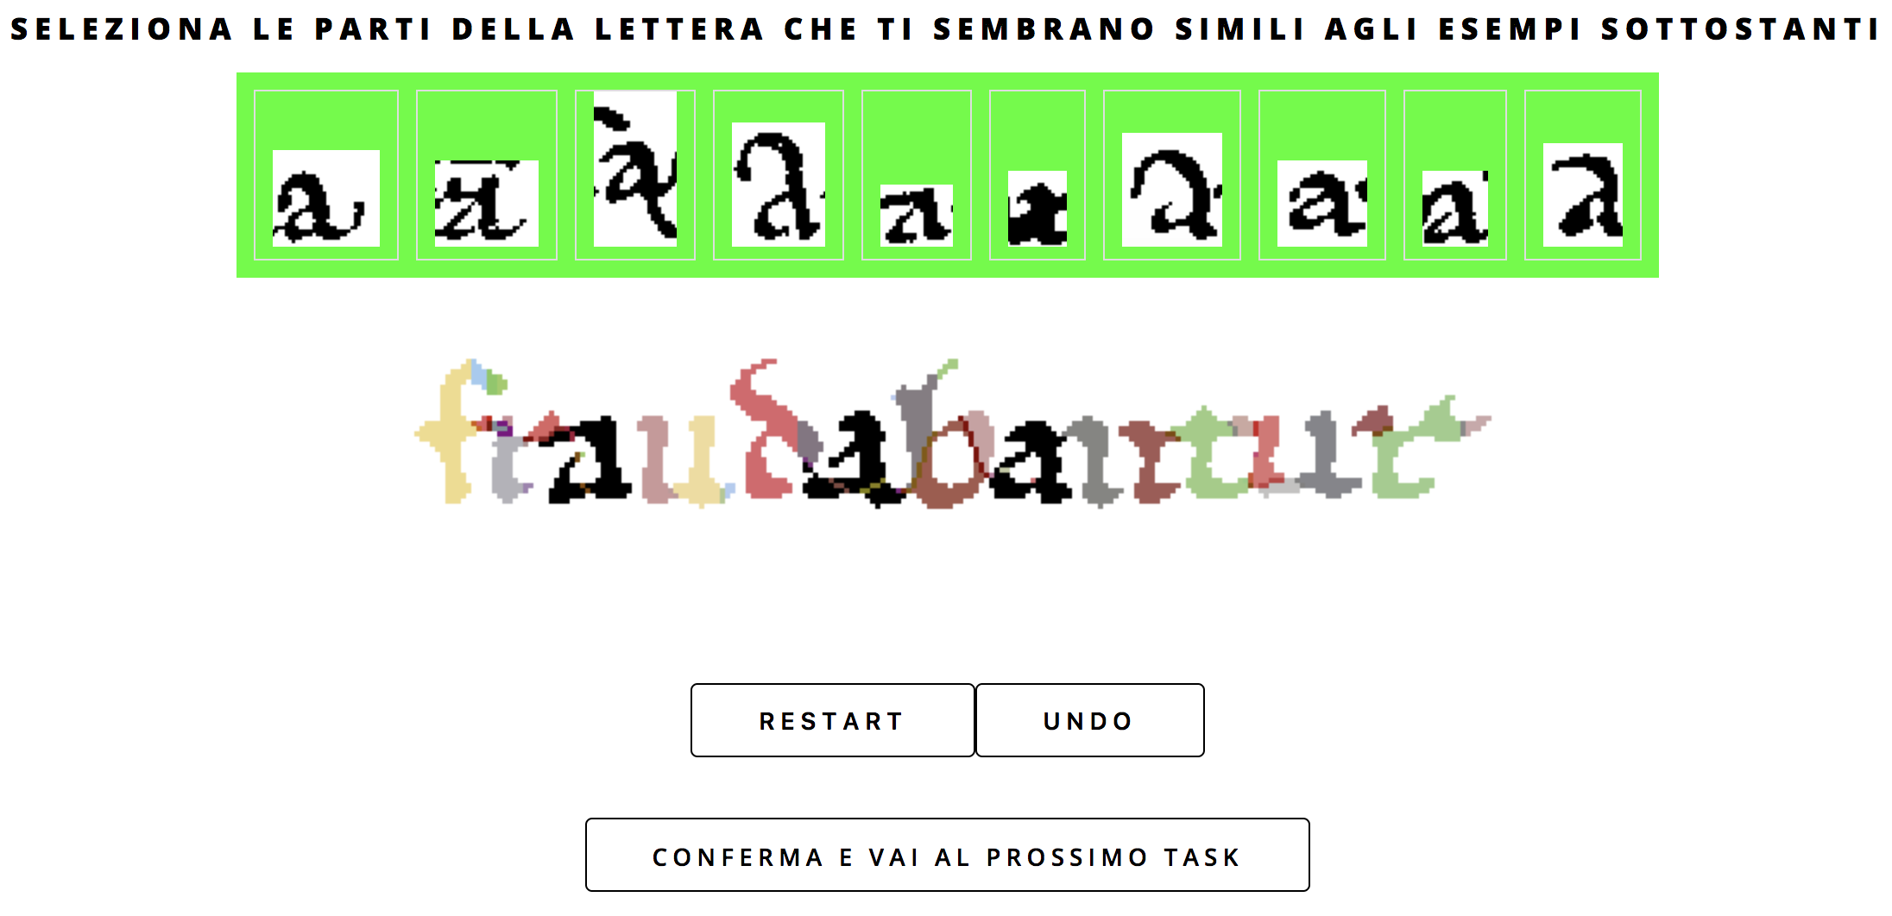

Slide 23
Third Mission (1/3)
700 students
from 26 schools
10M images
processed

Slide 24
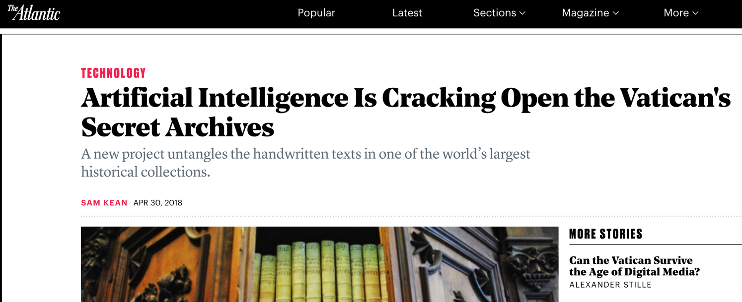
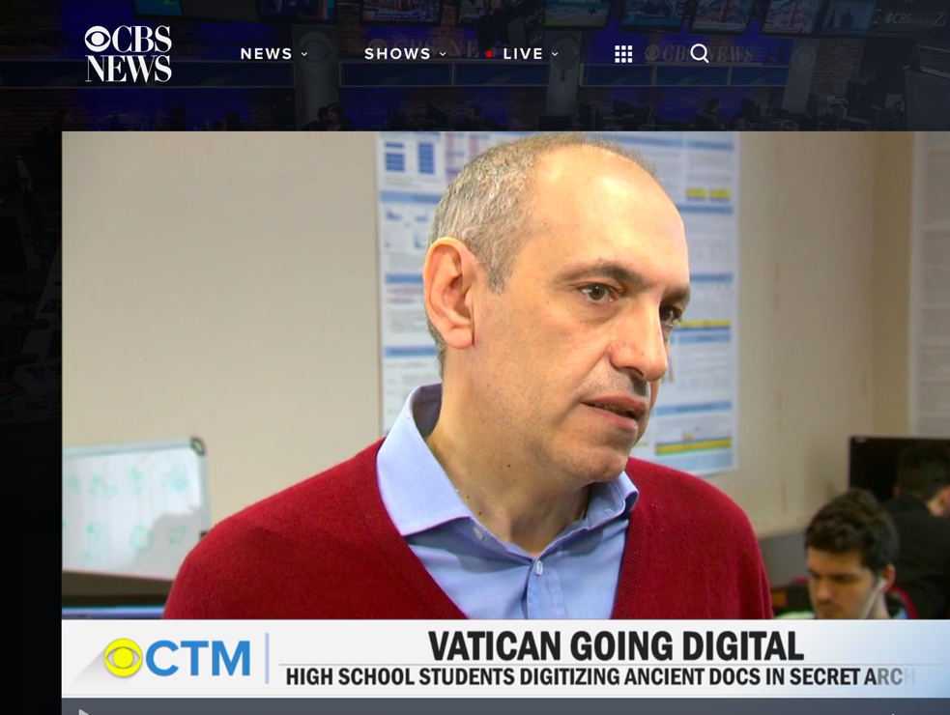
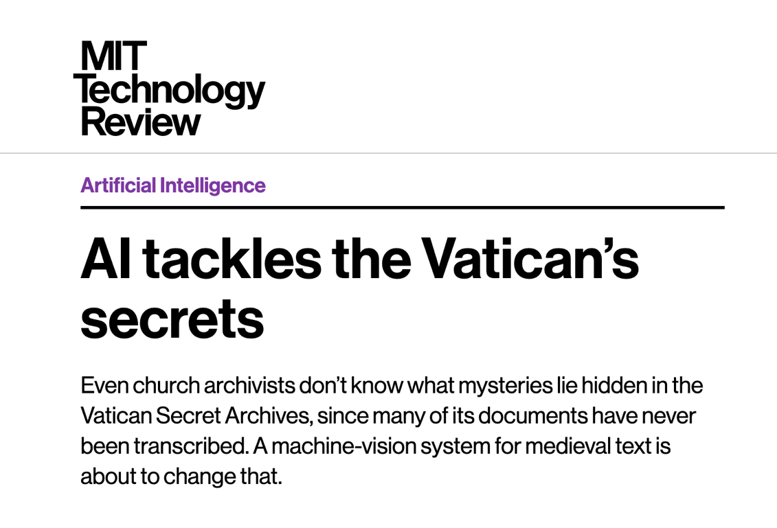
Third Mission (2/3)
Many media (news
papers, magazines, TV)
reported on our project

Slide 25
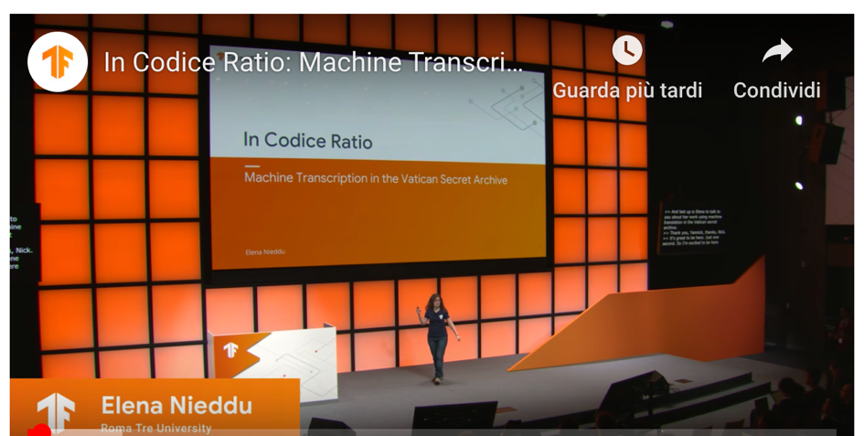
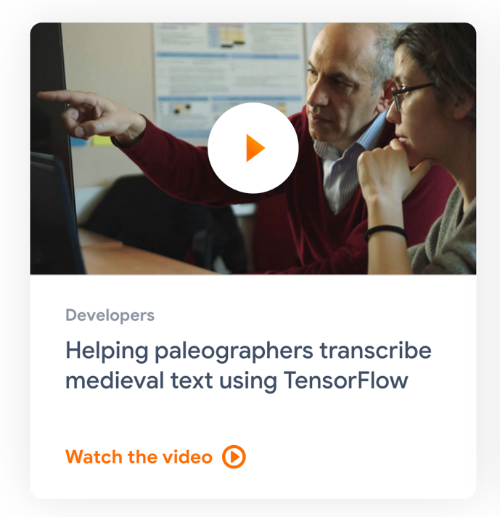
Third Mission (3/3)
Google has selected
our research as
showcase project for
their AI platform
Elena Nieddu (PhD student)
has been invited to give a talk at
  Google Tensorflow Dev Summit 2019
  Fantastic Futures 2019: a conference organized by Stanford Libraries
http://tensorflow.org
https://youtu.be/8khPUtwaVaw

Slide 26
RESULTS
Scientific results
Third mission
Technology transfer

Slide 27
Technology Transfer (1/3)
Technology Transfer Project with a local company (Lambo srl):
they need a solution to read and transcribe fiscal documents.
We customized our AI system to operate on the smartphone
It is in production!

Slide 28
Technology Transfer (2/3)
Technology Transfer Project with a local
company (Mediatica SPA):
they need a solution to classify legal documents
We have developed a system leveraging
many ideas and skills from the experience
with the manuscripts

Slide 29
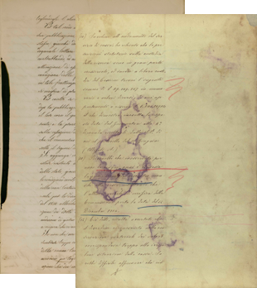
Technology Transfer (3/3)
We are going to start a project with
the Italian Chamber of Deputies to
transcribe historical manuscripts from their archives (Petizione 15 apr 1851,
Commissione di inchiesta sul Brigantaggio 1863,
Relazione Biagini Banca Romana 1889)
Opportunities also for humanities scholars

Slide 30
FUNDS

Slide 31
Funds
Programma Strategico Regionale per la ricerca, l'innovazione ed il trasferimento tecnologico 2017-2019 Legge Regionale n. 13 del 04/08/2008. Budget: €133.000
We have applied to FISR
(with CNR and Università della Campania "Vanvitelli")
We are working to apply to a H2020 call
(Curation of digital assets and advanced digitisation
DT-TRANSFORMATIONS-12-2018-2020)

Slide 32
Ad maiora

