Slide 1
Biologia Spaziale Applicata
Marta Del Bianco
www.asi.it
20/04/2023

Slide 2
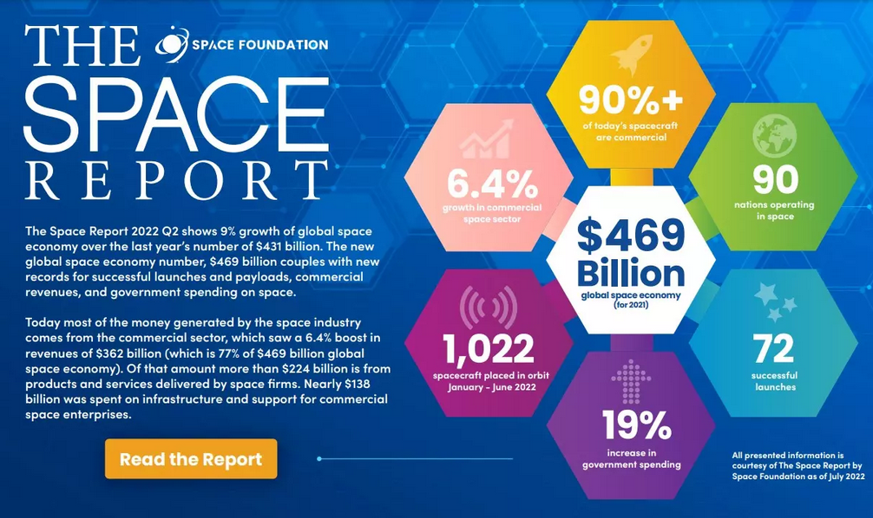
Impact of Space Exploration on Earth
SPACE ECONOMY
Space exploration is a driver for Economical growth worldwide.
SCIENTIFIC AND TECHNOLOGICAL ADVANCEMENTS
Biomedical knowledge and technologies
Pharmacological biotechnologies
Nanotechnologies
New materials
Climate change and sustainability
Food security
Notes:
Sarebbe quindi rilevante per il Rome Technopole e per il sistema Italia avere professionisti con un background spazio che capiscano le sfide future dell’esplorazione spaziale.

Slide 3
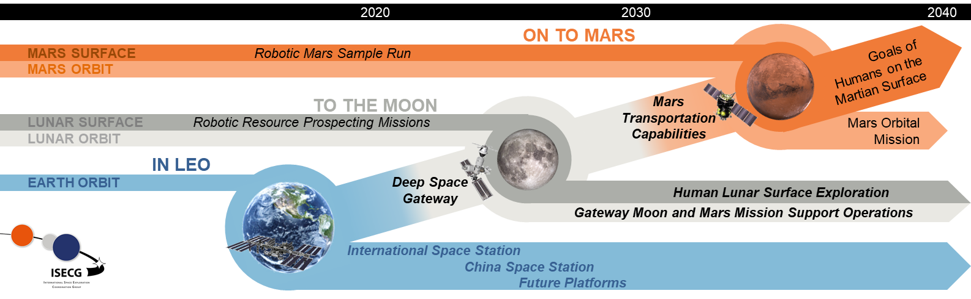
The History of Food in Space – The Future
doi:10.1111/j.1750-3841.2010.01982.x

Slide 4
The 5 Hazards of Space Exploration
Notes:
There are 5 main hazards associated with space exploration.
Some arise from the nature of the space environment itself. For example, being outside of the earth's atmosphere and magnetic field exposes the space craft and any form of life on board to high doses of radiations, which can be detrimental for any system. Being in freefall, away from a celestial body, or on a celestial body that is smaller than the earth, means that any system will experience reduced or absent gravity. From a biological point of view, we know that altered gravity has profound effects at both physiological and cellular level, but also from a technological point of view this is a problem, since systems have to be adapted to liquid behaviour in microgravity and the lack of convection flows.
The increase distance from the earth poses also a challenge, for self-sufficiency and medical emergencies.
Other challenges arise instead from the constrains of what type of environment we can create in space, being a spacecraft or a planetary base. Life in isolated close environment can have detrimental effects on the wellbeing of the crew and on their health, if the conditions are not properly set and pathogens are not contained. This is also true for those organisms that could be brought by the crew, like plants and beneficial microorganisms.
To optimise the national contribution to these global challenges we have organised four working groups in the life sciences macroareas that are of interest for space exploration.

Slide 5
Proposta Formativa
Target audience: - Scuole di Dottorato
- Corsi di Laurea Triennale/Magistrale
Lingua: - Italiano
- Inglese
Struttura modulare:
Modulo 1: conoscenze di base delle sfide fondamentali dell'esplorazione umana spaziale e degli effetti dell’ambiente spaziale sui sistemi biologici.
Modulo 2: a scelta tra una o più delle seguenti tematiche:
- biomedicina (diagnostica, monitoraggio e terapia in-situ, farmacologia di precisione)
- biofabricazione (3D bioprinting, tissue engineering)
- biotecnologie alimentari (microbiologiche e vegetali)
- sistemi chiusi biorigenerativi (waste recycling, sostenibilità)
- in-situ resource utilization (biomining, bioremediation)
- payload per la ricerca (definizione dei requisiti, design, integrazione)
Notes:
È stata pensata per adattarsi sia a scuole di dottorato che a

Slide 6
Thank you for your attention
ASI
Agenzia Spaziale Italiana
Via del Politecnico snc
00133 Roma, Italia
www.asi.it

