Slide 1

20th April, 2023
Technip Energies Italy
Gender Gap in STEM Disciplines

Slide 2


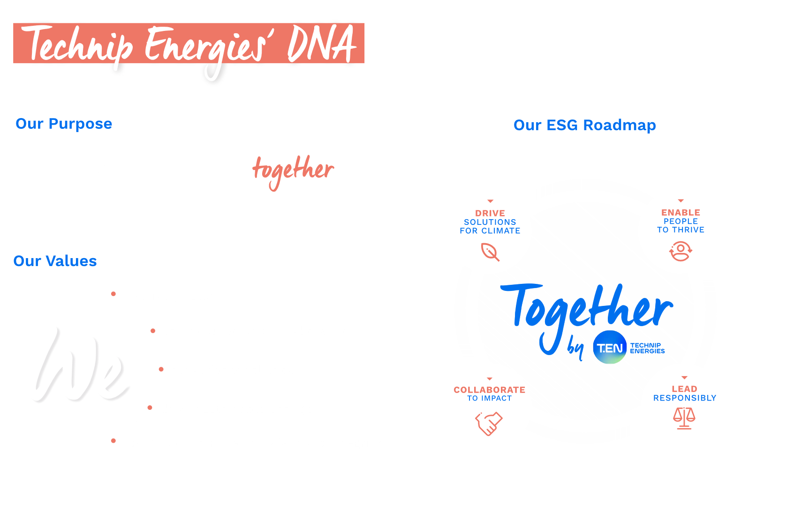
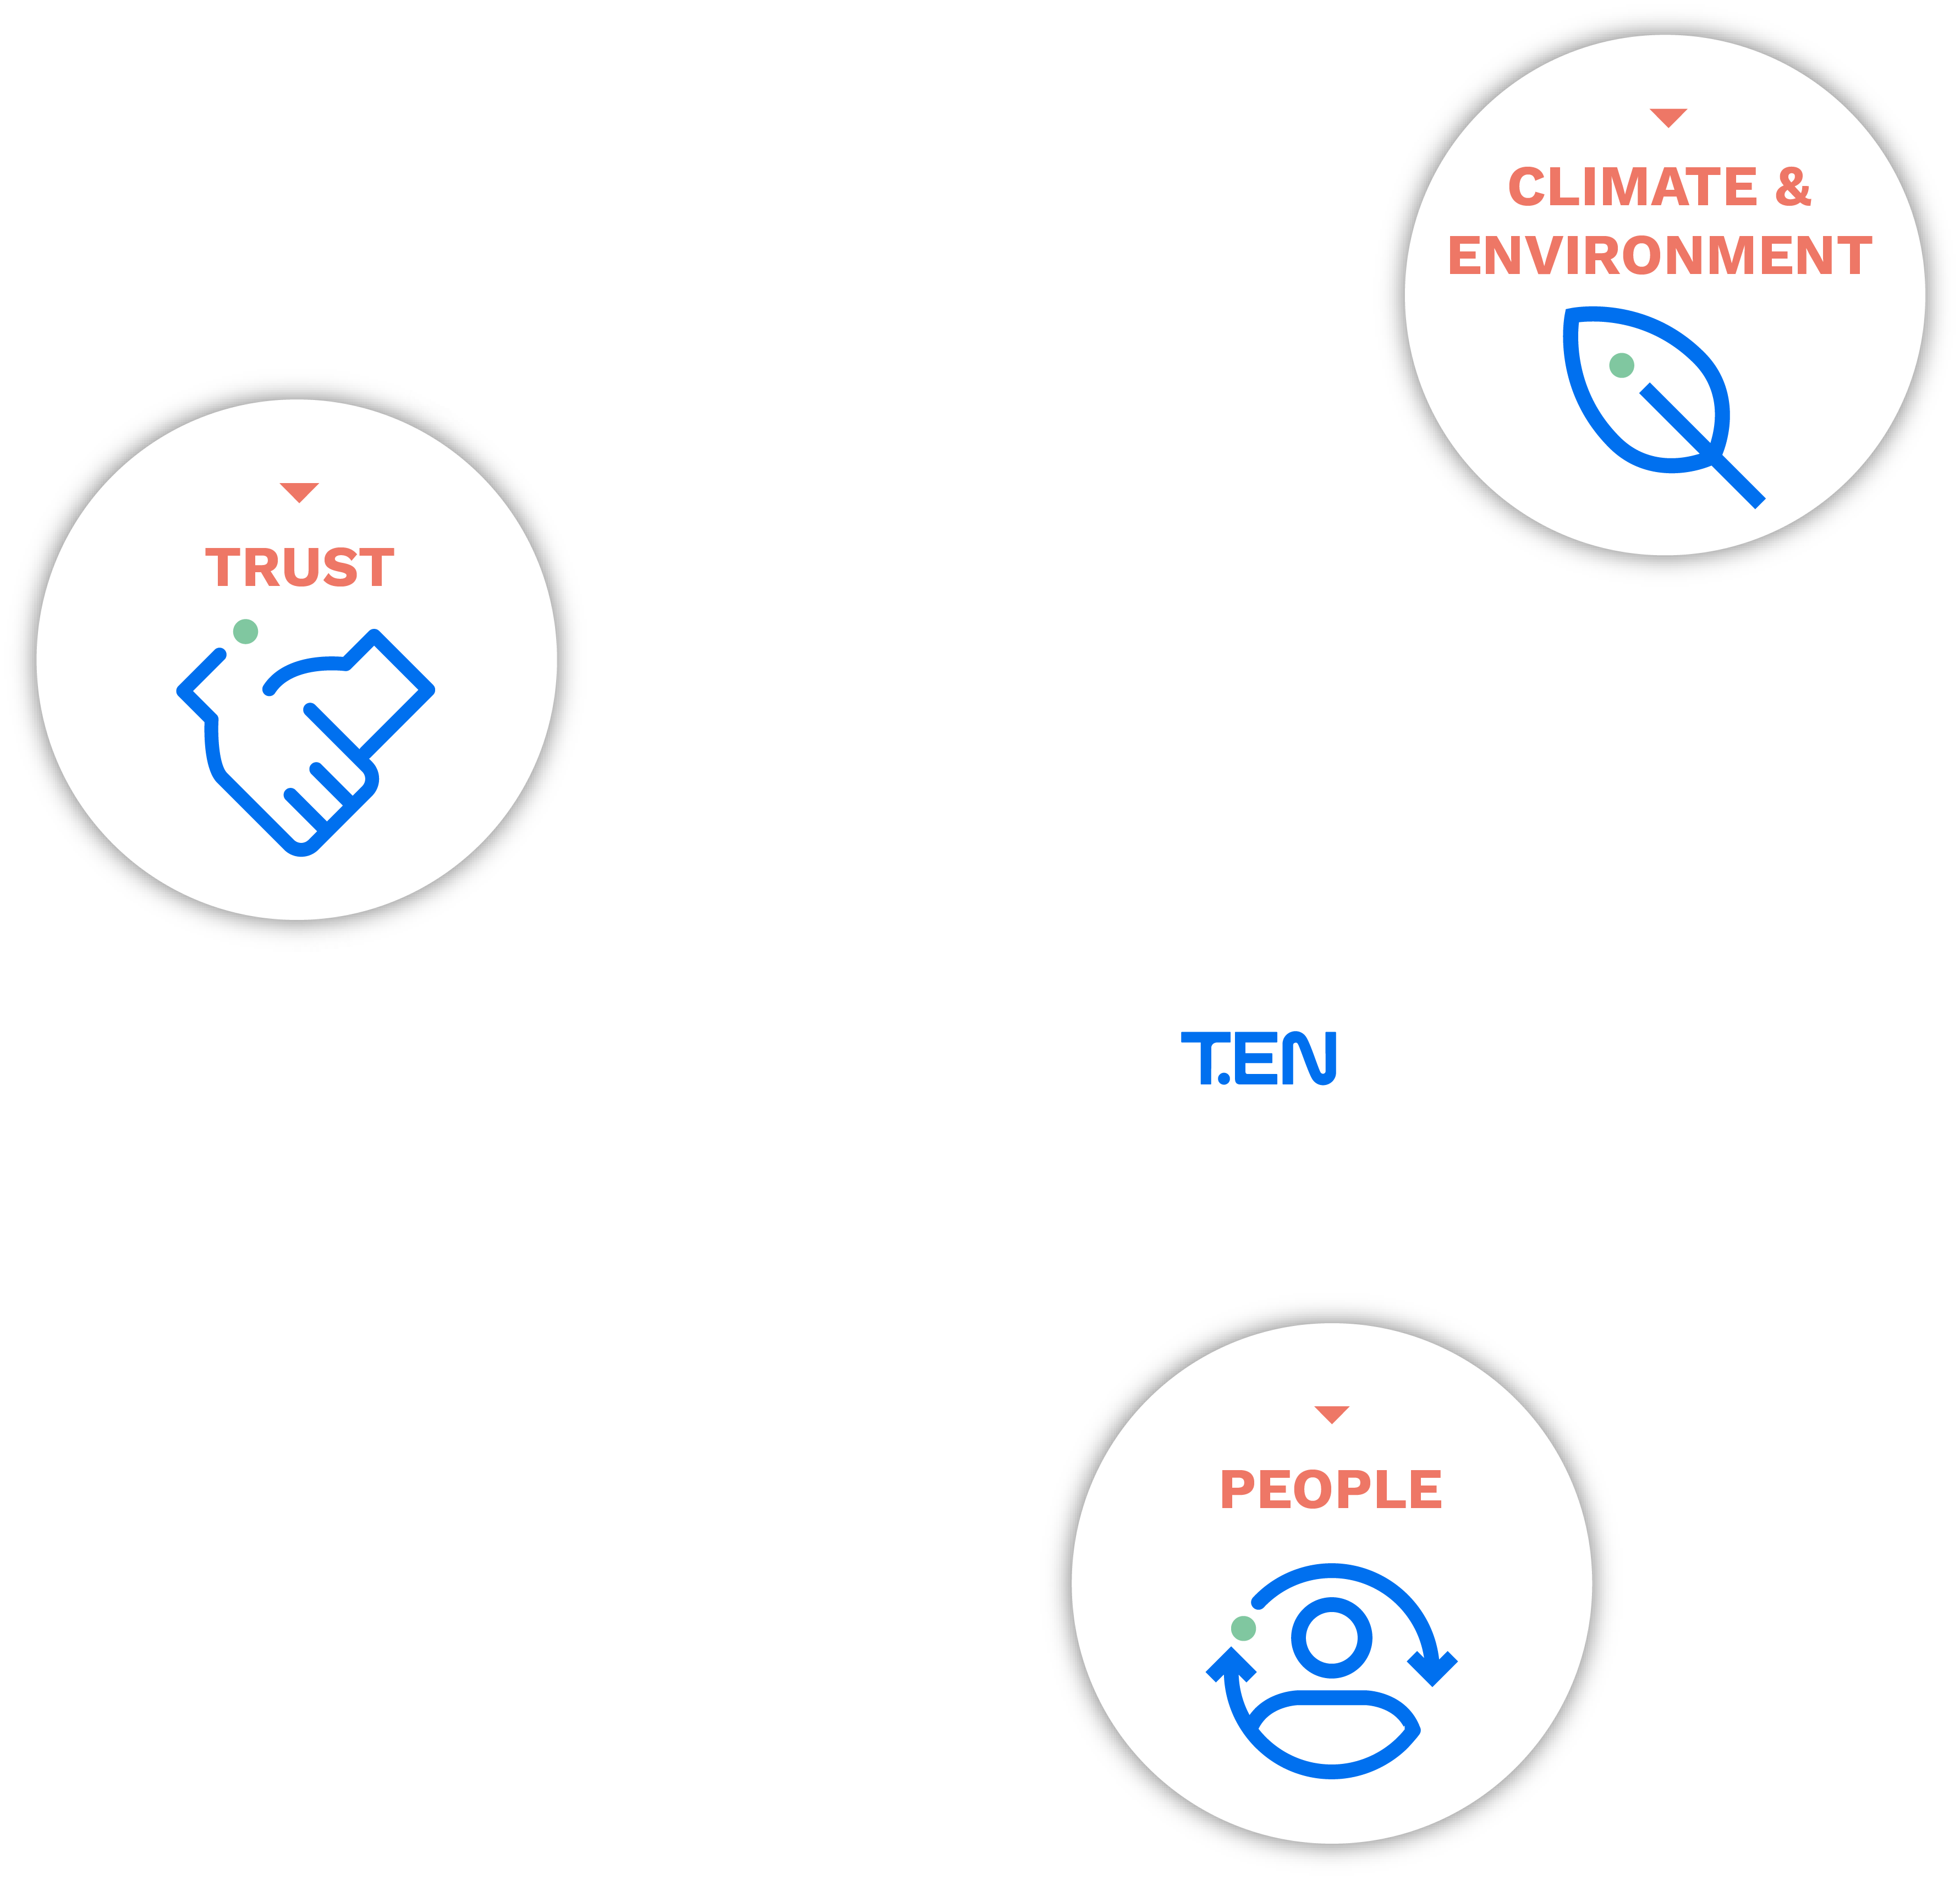

Our ESG Roadmap
2

Slide 3







Rome experienced, diverse and dynamic workforce
22
Nationalities
13y
Average seniority
(time spent at the Company)
30%
Women
37%
Millennials and Generation Z
67
Technical experts
with industry leadership
~124
Project managers¹
          ¹From project manager level 1 up to fellow executive project director, including project engineering and control managers.
3

Slide 4
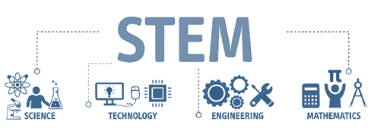

About STEM
Gender Diversity and STEM
Only 35% of STEM students in higher education globally are women
Only 3% of female students in higher education choose information and communication technologies (ICT) studies
Only 28% of all of the world’s researchers are women
STEM careers are often referred to as the jobs of the future, driving innovation, social wellbeing, inclusive growth and sustainable development.
Advances in STEM have already brought about improvements in many aspects of life, such as health, agriculture, infrastructure and renewable energy.
The future of our industry depends of the STEM professionals and their achievements.
(*) Science, Technology, Engineering and Mathematics
Source: Cracking the code: girls' and women's education in STEM – UNESCO, 2017

Slide 5
Why we need more woman in STEM
The equal participation and leadership of women and girls in science, technology, engineering, and math (STEM) disciplines is more important than ever. Addressing existing underrepresentation could not only bolster technological growth and innovation, but it’s also an economic necessity. In Europe, for instance, if companies were to double the share of women in the tech workforce to about 45 percent, or an estimated 3.9 million additional women by 2027, GDP could get a boost of as much as €260 billion to €600 billion.
MCKynsey & Company
“Diverse and inclusive cultures are providing companies with a competitive edge over their peers.” This quote summarizes conclusions from The Wall Street Journal’s first corporate ranking that examined diversity and inclusion among S&P 500 companies.
Forbes
Teams of employees make important decisions in organizations and are central to many business operations. As teams have become a mainstay in business practices, research has increasingly become focused on what elements make a team most successful. One potential determinant of a team’s effectiveness is its gender diversity, as the gender mix of a team may offer an assortment of knowledge and skills.
HARVARD Gender Action Portal

Slide 6
T.EN Italy Demographics
Similar figures for graduates and non-graduates, but lower % among Engineers (24% vs 29% females overall), even though we have a +1% in female Engineers’ population
Looking into career progression, a clear «funnel effect» appears, the higher the level, the lower the % of women
Increasing variance in average age and seniority (women slightly younger and less experienced), due to 50% female fresh graduates intake
Changes vs 2021 :
Slight increase of female presence (+1%) due to female fresh graduates’ inflow (50% of total graduats’ inflow, with impact on C3 and B2 levels)
Higher fork in average age and seniority (almost equal in 2020, then progressively increasing)
Further improvement of female presence in early stage of career and A2 contractual level
| 6

Slide 7
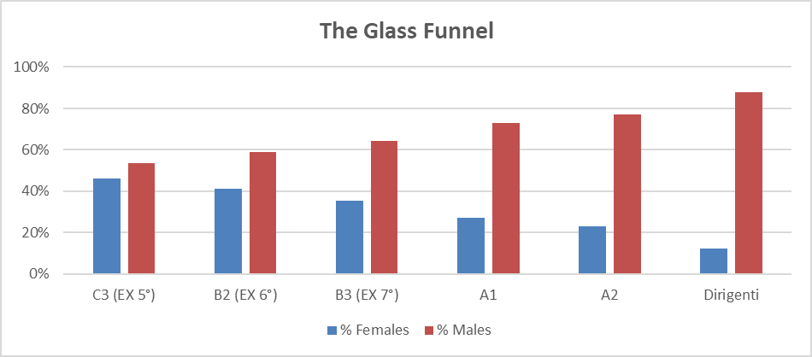
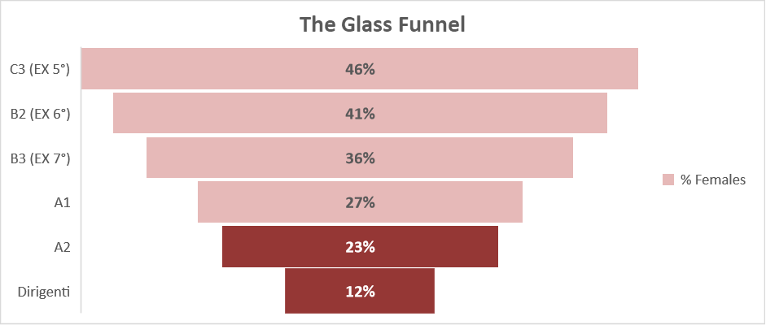
Career Progression : a «glass funnel» ?
Women still under-represented in these categories
With the increase of contractual level/Grade, the % of women progressively decreases. At Q8 level (13.2) the % of women starts decreasing compared to Company overall figure (30%), and, as we move upwards, there is a sharper decrease, showing a -7% in the next level (Q9 – 14.1) and another -11% if we consider Managers (dirigenti = 14.2 and above). This is the main area to be investigated : why less women than men make it to the top of the Organization ?
On a more positive note, we have a +2% in A2/Q9 female population, so a small, but visible improvement.
No change still at the level of Dirigenti (12% female presence, as per last year)
| 7

Slide 8

Where does T.EN Italy stand ?
Main Kpis to measure impact of D&I action plan
Diversity Enablers
 | 2023 Country Target | 2023 Country status | Country Target | Global Target
Women in Graduate Intake | 50% | 50% | 50% | 50%
Women in Leadership roles (%,#) | 12.5% TBC** | 13.8% | 18% In 2025 | 25% in 2025
Women in Permanent roles (%,#) | TBC** | 30% | 35% In 2030 | 35% in 2030
1.9%
29.4%
13.6%
Country Women resignation rate
Country Women hired in permanent role YTD
Country Women promotion rate YTD
All data as of Month /Day/Year

Slide 9

