Slide 1

Addressing Global Talent Shortage in Biotech Industry

Slide 2
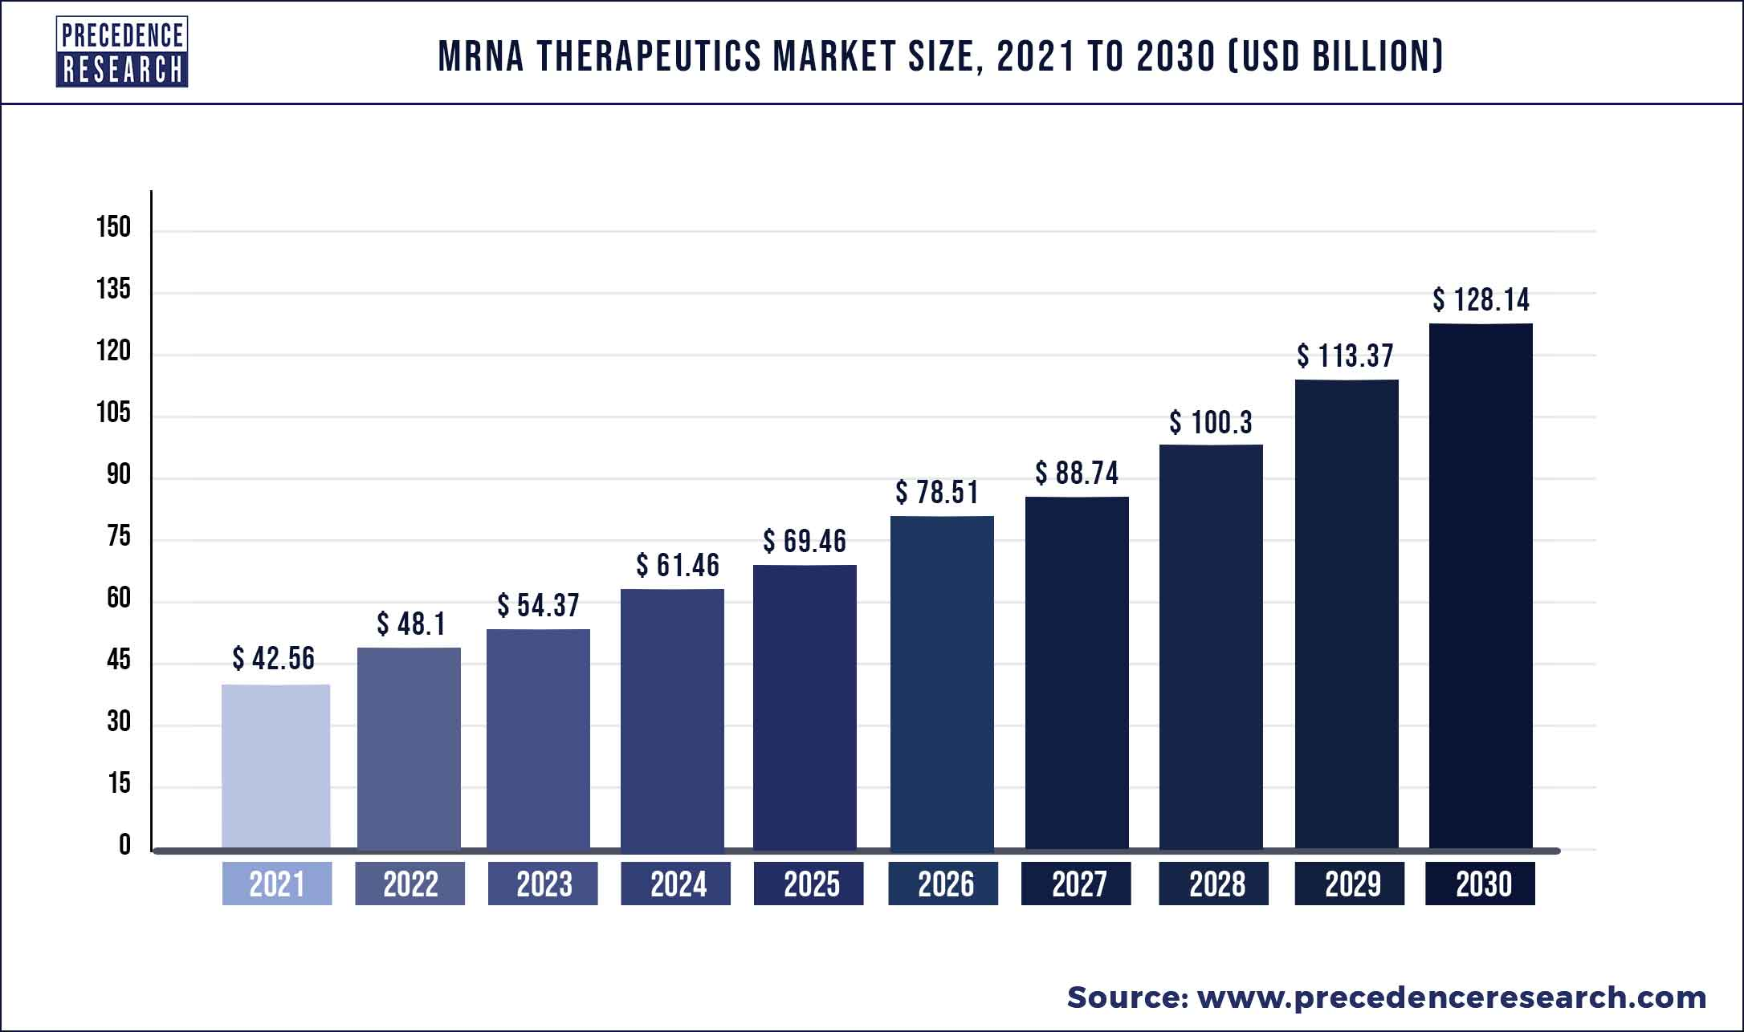
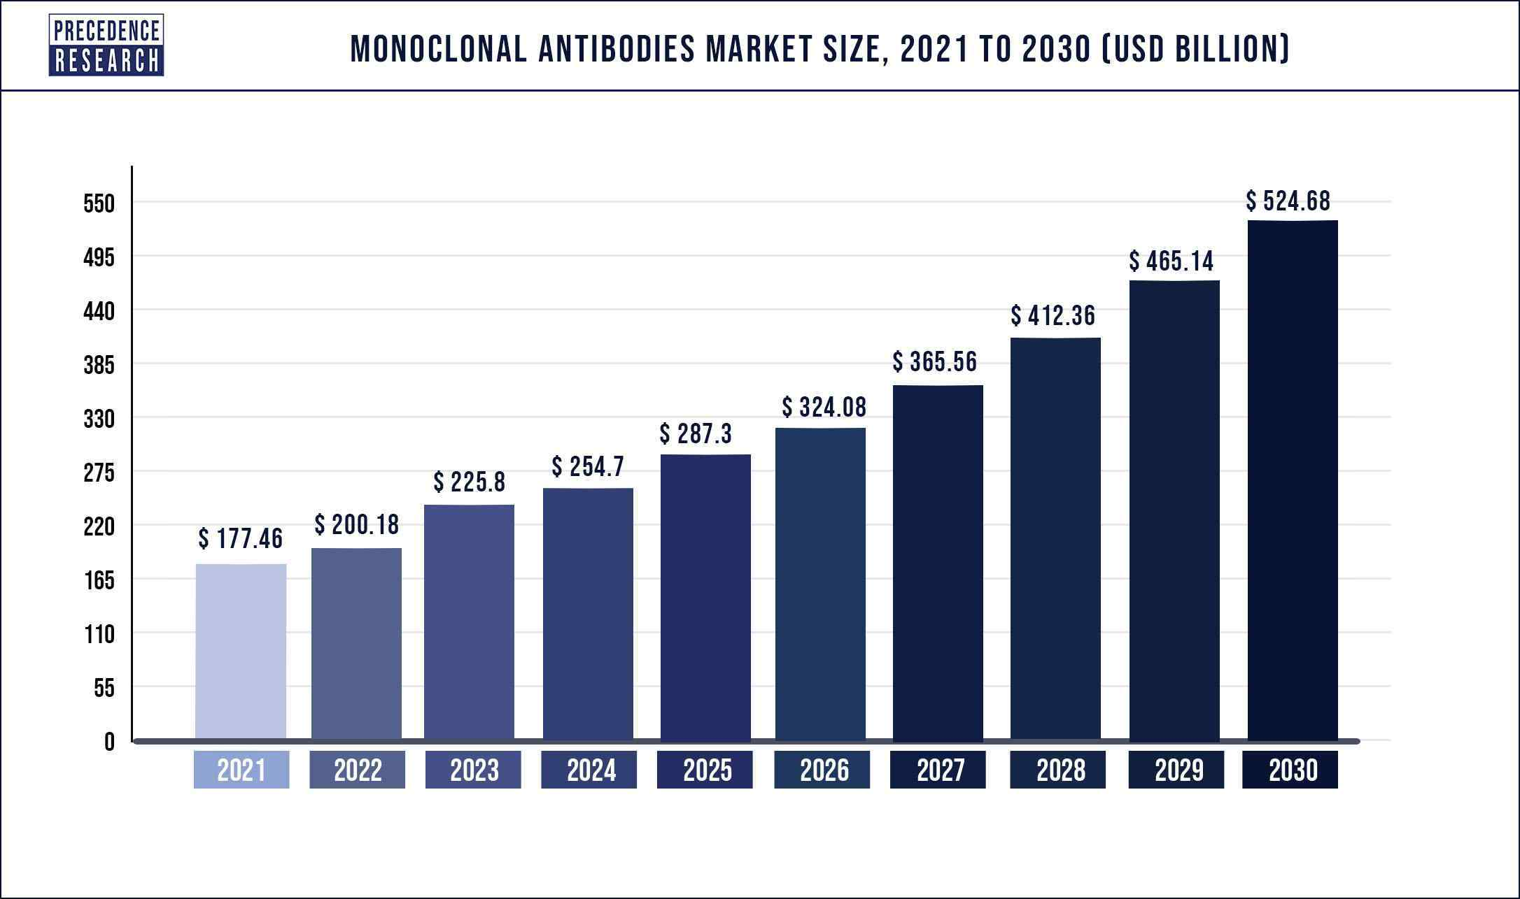
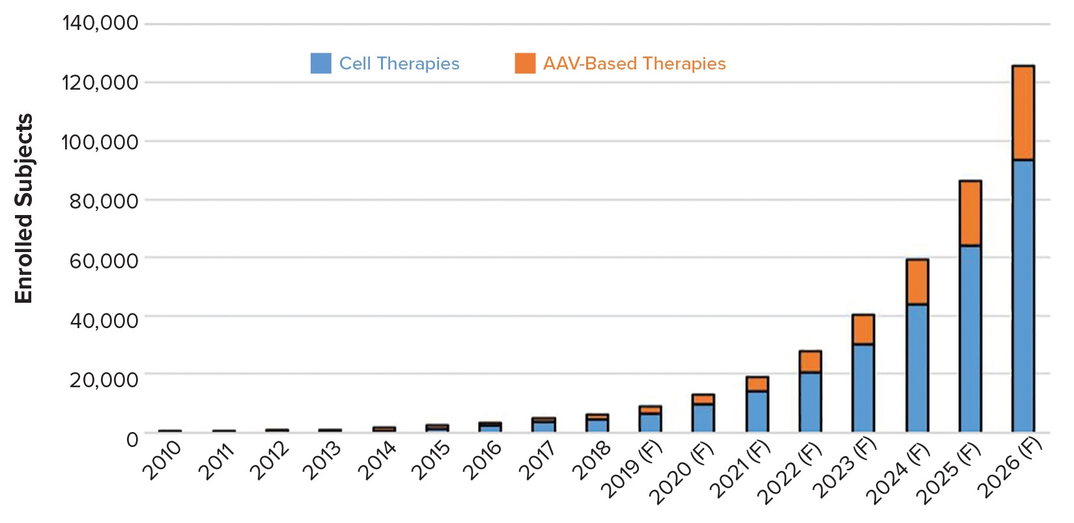
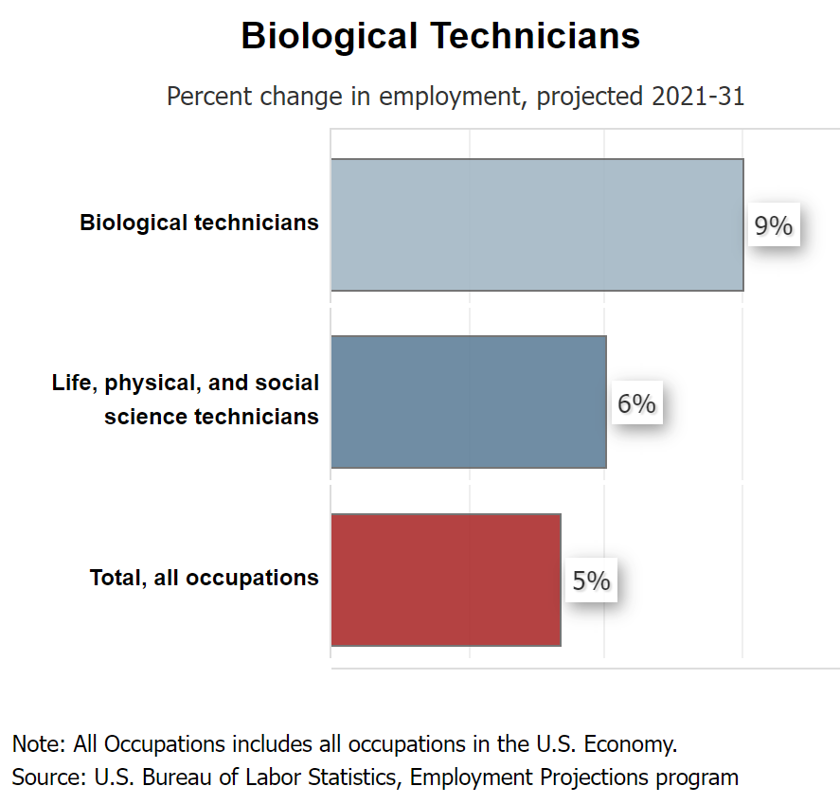
PROBLEMS:
BACKGROUND:
The Biopharmaceutical industry is growing exponentially.
Cell&Gene Therapy and mRNA are rapidly adding pressure to the manufacturing labor market.
The main requested skills are:
GMP knowledge
Process Development
Statistics
Experience with Bioreactors, Chromatography,…
Quality Control
Quality Assurance
A shortage of skilled workforce in biotech is anticipated in the next years
The gap between Academia and Pharmaceutical industry workforce need is still significant
Low-Medium Income Countries are rapidly adding new manufacturing capacity

Slide 3
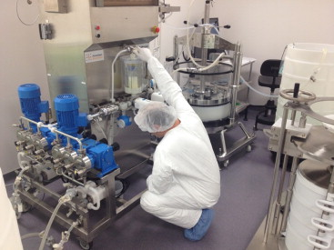
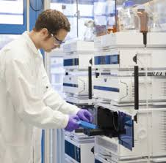
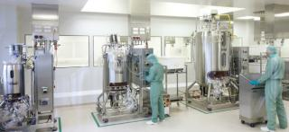
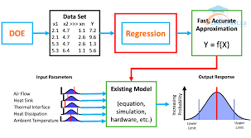
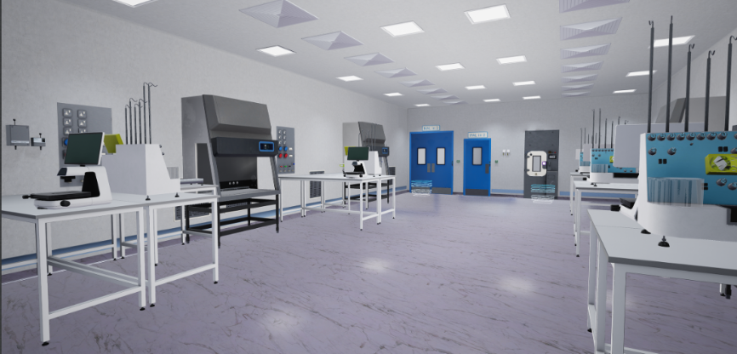


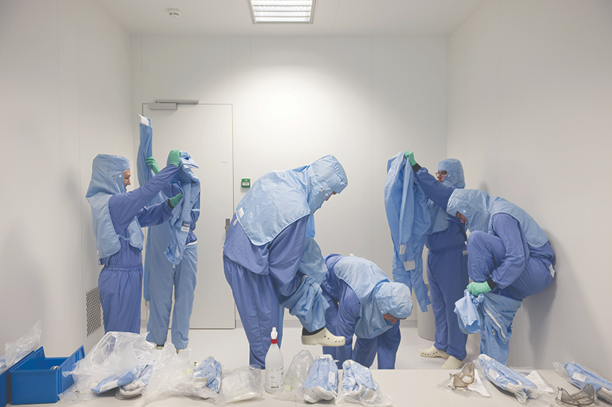
SOLUTION:
Biotech Academy in Rome offers a complete set of training courses that aim at:
  Increasing the quality and quantity of skilled workforce;
  Filling the gap between Academia and Industry.
Advantages:
Training held by international industry professionals;
Training sessions in a real GMP dedicated facility;
Hands-on courses;
Online courses;
Virtual Reality;
Tailored training (mRNA, mAbs, ATMP).

Slide 4
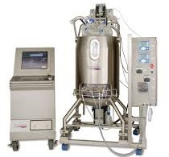
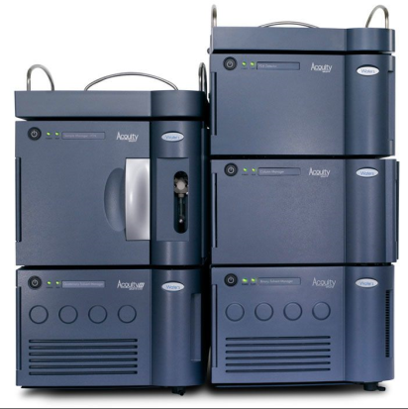
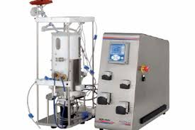
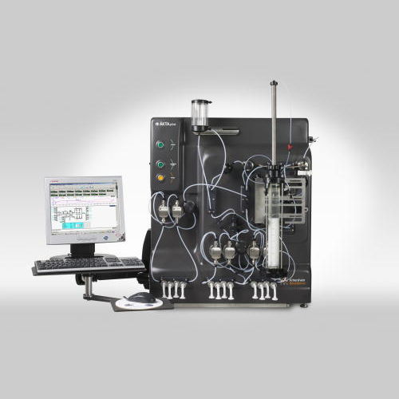
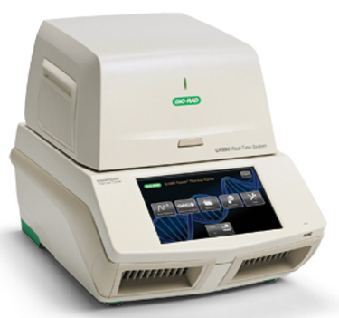
CURRENT AVAILABLE TECHNOLOGY
A broad range of technology is available;
Based on customer needs, new technologies can be implemented and tailored for different manufacturing processes.
Technology | mAbs | Recombinant Vaccines | mRNA
Shake flask incubator | √ | √ | √
Wave bioreactor | √ | √
Single Use Bioreactor 200 L | √ | √
Benchtop Single Use Bioreactors | √ | √ | √
Single Use MIxers | √ | √ | √
Chromatography Units | √ | √ | √
Single Use TFF | √ | √ | √
Real Time PCR | √ | √ | √
HPLC | √ | √ | √
Biosafety Cabinets | √ | √ | √
LN2 cells storage | √ | √
Metabolites analyzer | √ | √
Autoclave | √ | √ | √
… and more

Slide 5









COMPETITION LANDSCAPE
In person
VALUE PROPOSITION
Unique player in Europe offering comparable services;
Potential to be a training hub at least for the LATAM and EMEA;
Course space secured in real GMP facility;
Tailored on client needs;
Teachers are selected among industrial professionals with outstanding track record;
Basic online/digital courses can be developed to attract new customers or address timing/scheduling needs of participants
Mass /
Standardized
Niche /
Tailored
Online

Slide 6






SUSTAINABILITY
Best in class, very specific tailored courses for all levels of experience to promote lifelong learning for all.
Specialized trainings will support the development of new biopharmaceutical manufacturing sites globally, reducing supply chain disruption for critical medicines and increasing job opportunities worldwide and safeguarding the well being of patients.
For trainings and demonstrations, Biotech Academy in Rome has secured partnerships to collect materials which would otherwise be discarded because unsuitable for commercialization (e.g. expired, minor defects).

Slide 7











Founders:
Leonardo Sibilio, CEO: > 20 y of experience in Biotech Industry
Valerio Branchi, BD Director: > 25 y of experience in Healthcare sector
Niccolò Fanelli, CFO: > 15 y of experience in Health&Pharma sectors
Company:
100% private company
100 k€ Pre-seed funding (involvement of an US fund and synergical professionals in the field)
Collaborations:
... And a wide array of teachers and trainers with outstanding professional record in major multi-national companies!

